Slide 1
A Climate Trends ‘Roadmap’ for Transportation
Dr. Esther Mullens
Dr. Renee McPherson
South Central Climate Science Center
Norman, OK
March 27 2018

Slide 2
Thanks to
Jessica Blackband (SC-CSC)
Toni Klemm (TX A&M)
Cerry Leffler (SPTC)
Gerald Miller (SPTC)
Darby Perry (SC-CSC)
Mike Richman (OU SoM)
Derek Rosendahl (SC-CSC)
Mark Shafer (SCIPP)
Musharaf Zaman (SPTC)
All survey respondents
Grants:
SPTC-105336600
USO-122799700
NSF-OIA-1301789

Slide 3
In what ways do weather, climate and transportation intersect?
Notes:
Links for the above images?

Slide 4
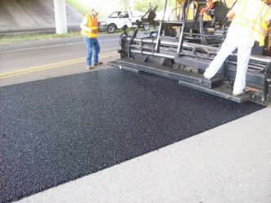
In what ways do weather, climate and transportation intersect?
Design
Asphalt binders, e.g., 64-22OK, 70-28OK…
Oklahoma DOT Drainage Manual Ch. 7.
Bridges (image from R. Hagedorn thesis, U. Ark, 2016)
Notes:
Precip extremes used to determine drainage requirements, based on potential flood depths, and rainfall return periods, as well as land surface characteristics.
Asphalt binders incorporate information on the highest and lowest potential pavement temperatures the region could experience, based on climate and traffic volume
Bridge design. Uneven heating of bridge girder sections can lead to large uneven temperature gradients that may stress the structure.

Slide 5
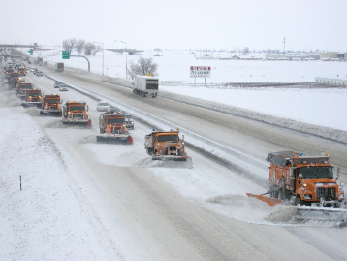
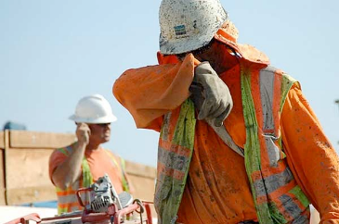
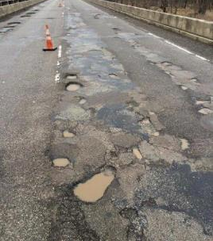
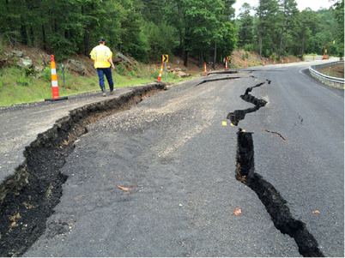
In what ways do weather, climate and transportation intersect?
Maintenance
Notes:
Links for the above images?

Slide 6
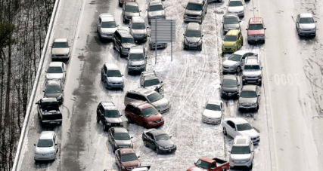
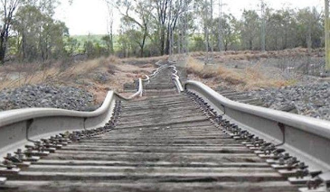
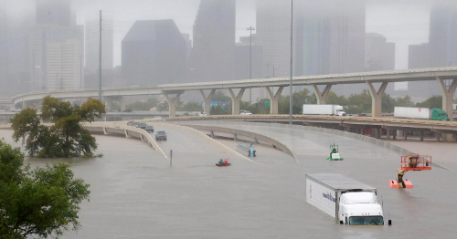
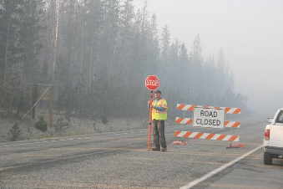
In what ways do weather, climate and transportation intersect?
Safety
Notes:
Links for the above images?

Slide 7
We tend to assume that our climate is variable but stationary…
Past
Future
Notes:
Links for the above images?

Slide 8
What if it isn’t stationary?
Past
Future
Notes:
Links for the above images?

Slide 9
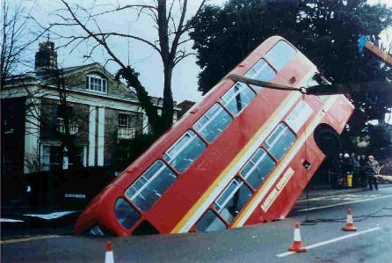
“The greatest danger in times of turbulence is to act with yesterday’s logic”
- Peter Drucker
Notes:
Links for the above images?

Slide 10
“The greatest danger in times of climate change is to act only with yesterday’s climate”
Notes:
Links for the above images?

Slide 11
Notes:
Recognize that climate change has unfortunately become highly politicized, and as a result an open dialogue on the subject can be difficult. I am going to assume that those listening have a working knowledge of the issue, and agree with the basic premise of climate change. If that isn’t the case I’d be happy to discuss that with you another time.

Slide 12
Introducing the State Climate Summaries!
What Can Transportation Agencies Do To Build Resilience?
Step 1: Know your vulnerabilities
-FHWA
Our mission was to provide transportation-relevant climate trends at the regional
level for each state in the SPTC/DOT region 6, and make this information, and
further resources, accessible to transportation professionals.
A second but no less important aim is to get a conversation started. How can we
help each other adapt to weather and climate challenges?
Notes:
Came out of the research that we did. Just talk about the process of thought that lead to these.

Slide 13
Introducing the State Climate Summaries!
Notes:
We’ll be going through the Oklahoma summary to show what is contained in these documents

Slide 14
A Preview of the Oklahoma State Climate Summary
Notes:
Table of contents – lays out what we looked at, numbers are linked to the relevant pages, so you can skip ahead to your page of interest if desired.

Slide 15
A Preview of the Oklahoma State Climate Summary
Notes:
Executive summary highlights the motivation and key findings. So for those with little time, this provides the main gist of the results.

Slide 16
A Preview of the Oklahoma State Climate Summary
Notes:
Basic transportation statistics for various aspects of the transportation sector – there is a second page also. For each asset type, the weather stressors are indicated, and the icons are used throughout the document.

Slide 17
A Preview of the Oklahoma State Climate Summary
Notes:
We’ll be going through the Oklahoma summary to show what is contained in these documents

Slide 18
A Preview of the Oklahoma State Climate Summary
Notes:
We’ll be going through the Oklahoma summary to show what is contained in these documents

Slide 19
A Preview of the Oklahoma State Climate Summary
Notes:
We’ll be going through the Oklahoma summary to show what is contained in these documents

Slide 20
A Preview of the Oklahoma State Climate Summary
Notes:
We’ll be going through the Oklahoma summary to show what is contained in these documents

Slide 21
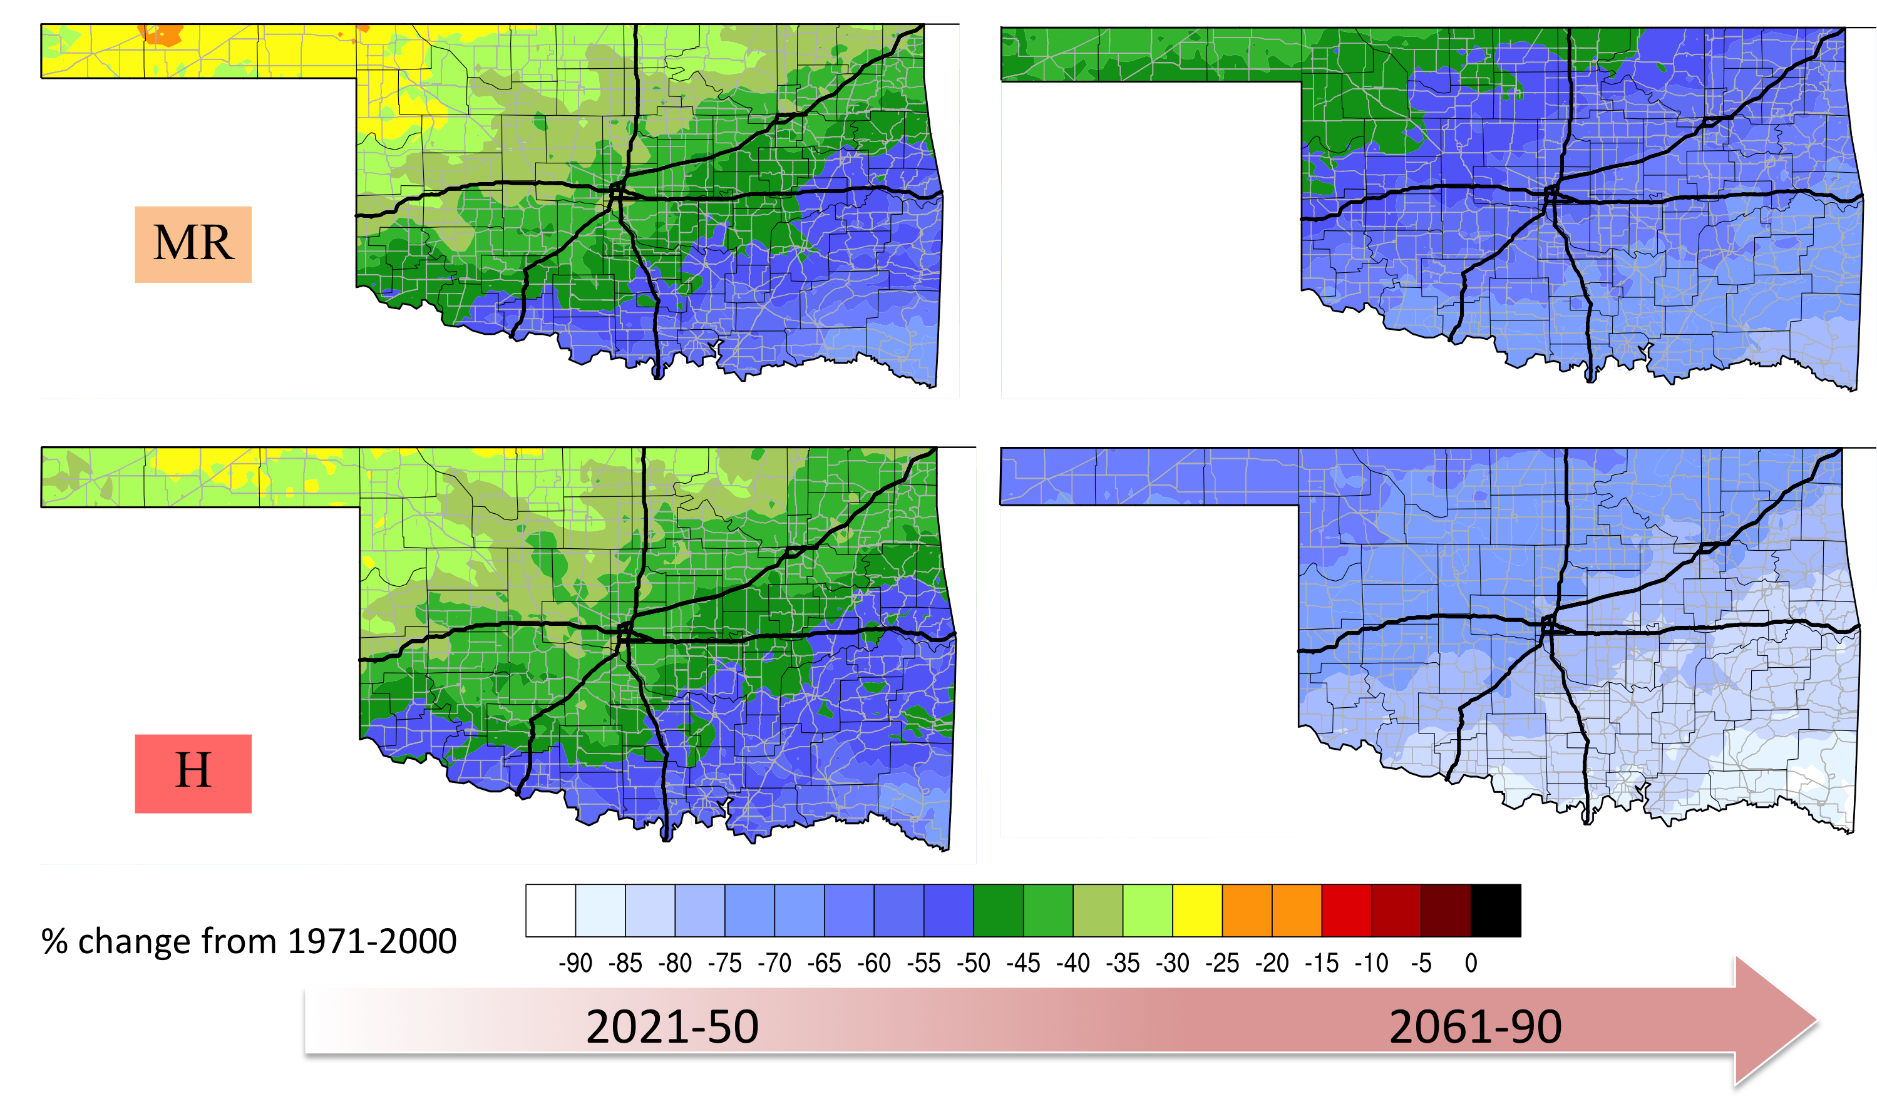
A Preview of the Oklahoma State Climate Summary
Notes:
We’ll be going through the Oklahoma summary to show what is contained in these documents

Slide 22
A Preview of the Oklahoma State Climate Summary
Notes:
Talk about why we selected certain regions (large or growing population, economic center etc.)

Slide 23
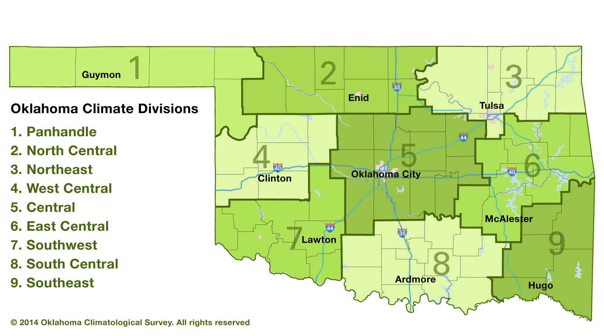
A Preview of the Oklahoma State Climate Summary
Notes:
Talk about why we selected certain regions (large or growing population, economic center etc.)

Slide 24
A Preview of the Oklahoma State Climate Summary
Notes:
Bring in real-world extreme years and evaluate their likelihood in the future. Explain the multi-model average at some point.

Slide 25
A Preview of the Oklahoma State Climate Summary
Notes:
Talk about calculating storm return periods for daily data. Why we did that, but some of the limitations (e.g., method used, large model spread, issues with projecting extreme events).

Slide 26
A Preview of the Oklahoma State Climate Summary
Notes:
Possible factor of 4 probability increase in a 100-year rainfall event in central OK by 2050.

Slide 27
A Preview of the Oklahoma State Climate Summary

Slide 28
A Preview of the Oklahoma State Climate Summary
Notes:
Talk a little about some of the limitations of this work. Acknowledge that incorporating this information can be challenging, and is often not legally required at this time, so incentive may be low.
Mention that there is a full references section with web links.
Full web addresses to most active links included in the references, in case you prefer to print this out.

Slide 29
A Preview of the Oklahoma State Climate Summary
Notes:
Talk about the appendix, what technical information is included. What the confidence measures were (somewhat subjective).

Slide 30
Some Q & A
Where can I get these documents?
I work near the coast, and I want more information on sea level rise…
Can I get the datasets and/or graphics used in this work?

Slide 31
Some Q & A
Where can I get these documents?
Project website: http://www.climateprojections.wixsite.com/transportation
I work near the coast, and I want more information on sea level rise…
The Texas and Louisiana summaries include basic information on sea
level rise and links to further resources.
Can I get the datasets and/or graphics used in this work?
Yes! We are beginning to populate a basic portal with downloadable
graphics and datasets for climate divisions and states. The grid-point level
data is available, but will require more technical expertise to use. User
guides will be provided. Expected completion summer 2018.
Go to: https://data.southcentralclimate.org/SPTC_Climate_Projections_Data_and_Images/
Notes:
Spend a bit of time showing what is currently available on the portal.

Slide 32
THANKS!
Questions? Feedback? Email esther.white@ou.edu until August 2018, and then emullens85@gmail.com, or renee@ou.edu while I transition to another institution. The data will remain with the SC-CSC.
If you have read your state’s summary, and have some comments on the document, please also email.

Slide 33
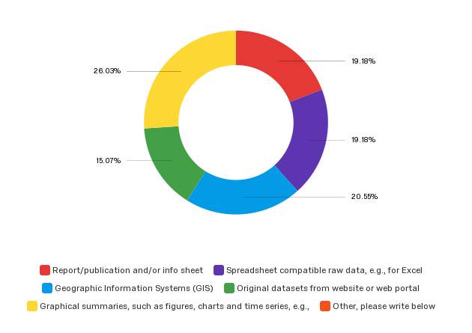
The format in which climate data is packed
e
a
19.2%
26%
b
19.2%
15.1%
d
c
20.6%
a
b
c
d
e
f

